Slide 1
Introduction
TCP provides a
connection oriented
reliable
byte stream service
The term connection oriented means the two application using TCP must establish a TCP Connection with each other before exchange data.

Slide 2
TCP services
There are exactly two end points communication with each other on TCP connection.
Does not support multicasting and broad casting .
Unit of information passed by TCP to IP is called a segment.
When TCP sends a segment it maintains a timer ,waiting for the other end to acknowledge.

Slide 3
TCP Service cont ..
If an acknowledgement isn’t received in time ,the segment is retransmitted .
TCP also provides flow control
A TCP connection is a byte stream not a message stream .

Slide 4
Flow Control
The receiver of the data controls the amount of data that are to be sent by the sender. This is done to prevent the receiver from being overwhelmed with data.
Error Control
To provide reliable service, TCP implements an error control mechanism.
Congestion Control
The amount of data sent by a sender is not only controlled by the receiver, but by the level of congestion in the network.

Slide 5
Error Control
Error control includes mechanisms for detecting corrupted segments, lost segments, out-of-order segments, and duplicated segments.
Error control also includes a mechanism for correcting errors after they are detected.
Error detection and correction in TCP is achieved through the use of three simple tools:
  checksum,
  acknowledgment, and
  time-out.

Slide 6
Checksum
Each segment includes a checksum field which is used to check for a corrupted segment.
If the segment is corrupted, it is discarded by the destination TCP and is considered as lost.
TCP uses a 16-bit checksum that is mandatory in every segment.
Acknowledgment
TCP uses acknowledgments to confirm the receipt of data segments.
Control segments that carry no data but consume a sequence number are also acknowledged.
ACK segments are never acknowledged.

Slide 7
Retransmission
The heart of the error control mechanism is the retransmission of segments.
When a segment is corrupted, lost, or delayed, it is retransmitted.
In modern implementations, a segment is retransmitted on two occasions:
  when a retransmission timer expires or
  when the sender receives three duplicate ACKs.

Slide 8
Retransmission After RTO:
A recent implementation of TCP maintains one retransmission time-out (RTO) timer for all outstanding (sent, but not acknowledged) segments.
When the timer matures, the earliest outstanding segment is retransmitted even though lack of a received ACK can be due to a delayed segment, a delayed ACK, or a lost acknowledgment
The value of RTO is dynamic in TCP and is updated based on the round-trip time (RTT) of segments

Slide 9
Retransmission After Three Duplicate ACK Segments:
Sometimes, however, one segment is lost and the receiver receives so many out-of-order segments that they cannot be saved (limited buffer size).
To alleviate this situation, most implementations today follow the three-duplicate-ACKs rule and retransmit the missing segment immediately.
This feature is referred to as fast retransmission.
Out-of-Order Segments
When a segment is delayed, lost, or discarded, the segments following that segment arrive out of order.
Data may arrive out of order and be temporarily stored by the receiving TCP, but TCP guarantees that no out-of-order segment is delivered to the process

Slide 10
Some scenarios
Normal Operation:
  The first scenario shows bidirectional data transfer between two systems
Lost Segment:
  A lost segment and a corrupted segment are treated the same way by the receiver.
Fast Retransmission
Congestion Control

Slide 11

Figure 23.24 Normal operation

Slide 12

Figure 23.25 Lost segment
The receiver TCP delivers only ordered data to the process.

Slide 13

Figure 23.26 Fast retransmission

Slide 14
Error Control in TCP
TCP maintains a Retransmission Timer for each connection:
  The timer is started during a transmission. A timeout causes a retransmission
TCP couples error control and congestion control (i.e., it assumes that errors are caused by congestion)
  Retransmission mechanism is part of congestion control algorithm
Here: How to set the timeout value of the retransmission timer?

Slide 15
TCP Retransmission Timer
Retransmission Timer:
  The setting of the retransmission timer is crucial for efficiency
  Timeout value too small → results in unnecessary retransmissions
  Timeout value too large → long waiting time before a retransmission can be issued
  A problem is that the delays in the network are not fixed
  Therefore, the retransmission timers must be adaptive

Slide 16
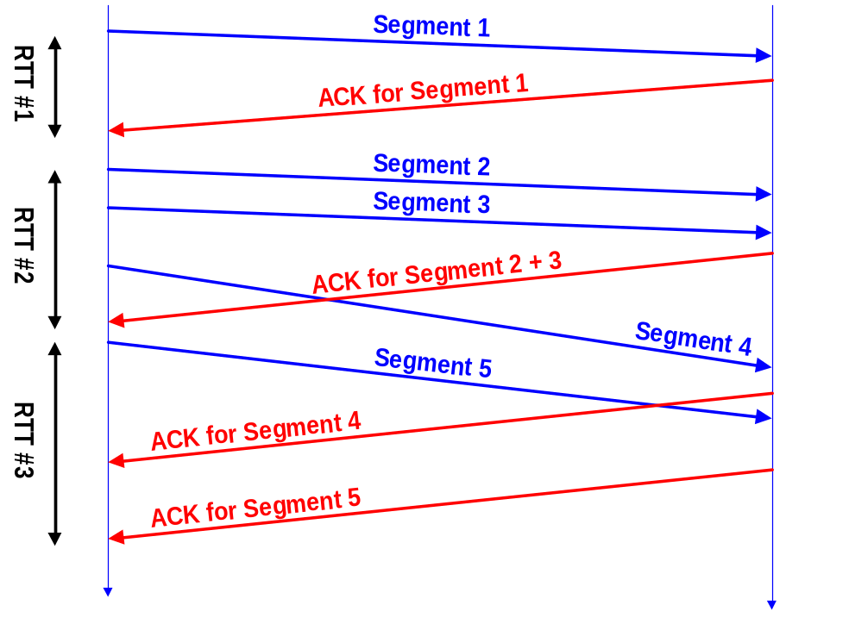
Round-Trip Time Measurements
The retransmission mechanism of TCP is adaptive
The retransmission timers are set based on round-trip time (RTT) measurements that TCP performs
The RTT is based on time difference between segment transmission and ACK
But:
  TCP does not ACK each segment
  Each connection has only one timer

Slide 17
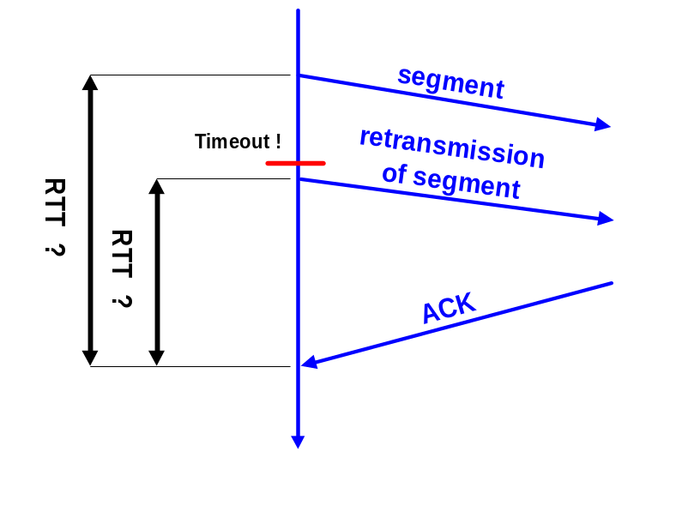
Karn’s Algorithm
If an ACK for a retransmitted segment is received, the sender cannot tell if the ACK belongs to the original or the retransmission.
Karn’s Algorithm:
  Don’t update srtt on any segments that have been retransmitted.
  Each time when TCP retransmits, it sets:
  RTO_{n+1} = max ( 2 RTO_{n}, 64) (exponential backoff)

Slide 18
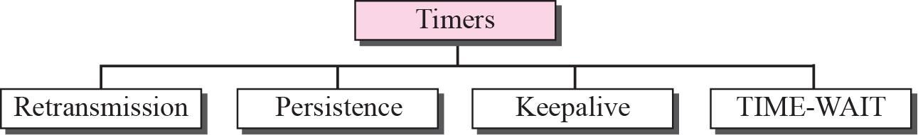
Figure 15.38 TCP timers

Slide 19
TCP Timer Management
Retransmission timer: is used when excepting an ack from other end.
Persist timer: keeps window size information flowing even if the other end closes its receiver window .
Keep alive timer: Detects when the other end crashes.
2 maximum segment life timer: measures the time a connection has been in the Time wait state

Slide 20
Fast retransmit/fast recovery
Fast retransmit and fast recovery are two important mechanisms to reduce the congestion threshold.
In a TCP, a receiver sends acknowledgements only if it receives any packets from the sender.
Whenever there is any gap in the packet stream, it may not always mean that the network is congested but also sometimes loss of some packet due to transmission error.
In such cases sender retransmit the missing packet before time out.
This process is called as Fast retransmit method
The receipt of acknowledgements shows that there is no congestion to justify a slow start.
The sender can continue with the current congestion window.
The sender performs a fast recovery from the packet loss. This mechanism can improve the efficiency of TCP dramatically

Slide 21
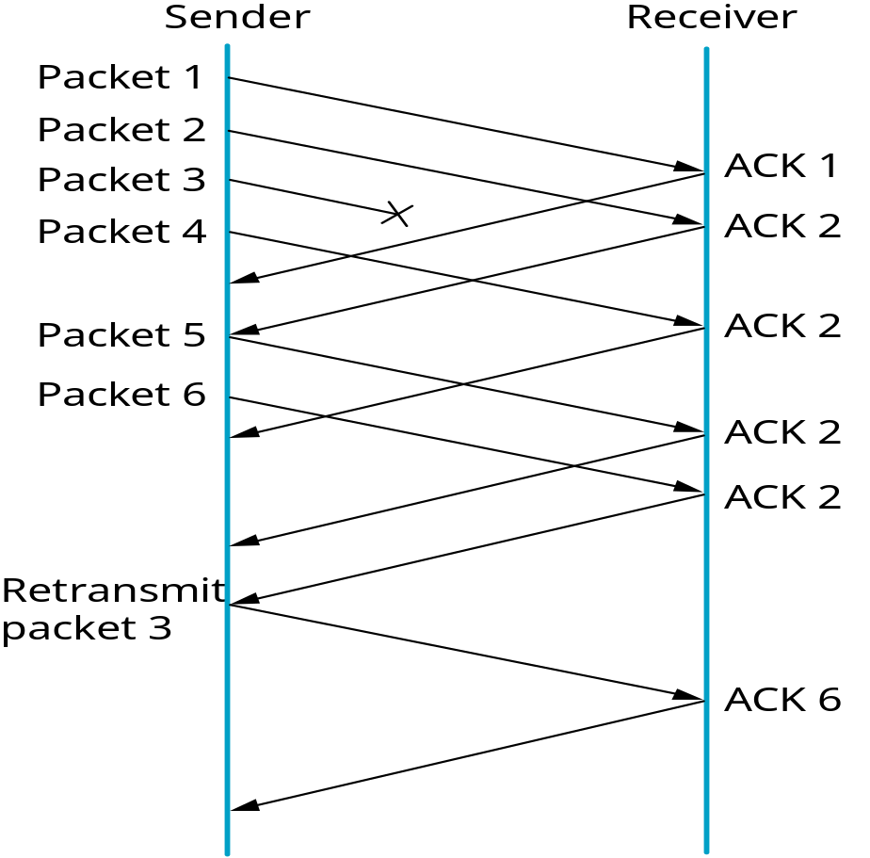
Advantages:
Simple approach
Only minor changes in the mobile host’s software already result in a performance increase
No foreign agent or correspondent host has to be changed
Disadvantages:
Insufficient isolation of packet losses
Mixed layers, not transparent

Slide 22
SILLY WINDOW SYNDROME
Silly window syndrome is a problem that can arise in poor implementations of the transmission control protocol (TCP).
It can lead to a significant reduction in network performance.
silly window syndrome happens when the receiver is only able to accept a few bytes at a time or when the sender transmits data in small segments repeatedly.
This leads to an increased number of small packets,

Slide 23
What Causes Silly Window Syndrome from the Sender Side?
On the sender's side, silly window syndrome can be caused by an application that only generates very small amounts of data to send at a time.
Even if the receiver advertises a large window, the default behavior for TCP would be to send each individual small segment instead of buffering the data as it comes in and sending it in one larger segment.

Slide 24
A Common Solution
Nagle's algorithm is one of the most common ways of dealing with silly window syndrome,

Slide 25
Nagle Algorithm
When TCP connection has outstanding data that has not been acknowledged, small segment cannot be sent until the outstanding data is acknowledge.
Instead ,small amount of data are collected by TCP and sent in a single segment when the ack arrives .
Nagle algorithm is self clocking.

